Slide 1

Case Study 3 Insurance Premium Data
Done by: Liaw Ying Ting, Celin

Slide 2
Problem Statement
Health Insurance data only profit if the premium collected outweighs the payout of its beneficiaries
Analyze the factors influencing premium cost

Slide 3
Data
Source of Data: https://www.kaggle.com/simranjain17/insurance
About the data:
7 Columns
1338 Rows
Explaining the data Columns:
Age | Age of the Policyholder
Sex | Gender of the Policyholder
BMI | An indicator of obesity Underweight (<18.5), Healthy (18.5-24.9), Overweight (25-29.9), Obese (>30)
Children | Number of Children the Policyholder has
Smoker | Whether the Policyholder smokes or not
Region | Which Region the Policy holder lives in
Charges | How much the policyholder is charged for the policy

Slide 4
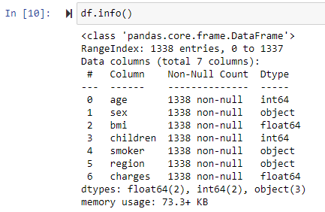
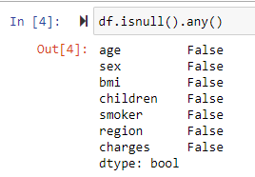
Cleaning the data
Completeness – No Null values
Df.isnull() – check for any missing data (No null values)
Format – Format is the same throughout all datas
Df.info – check for data type
Validity/Integrity – Data has been quoted and used by many people on kaggle
Data Type
No Null Value

Slide 5
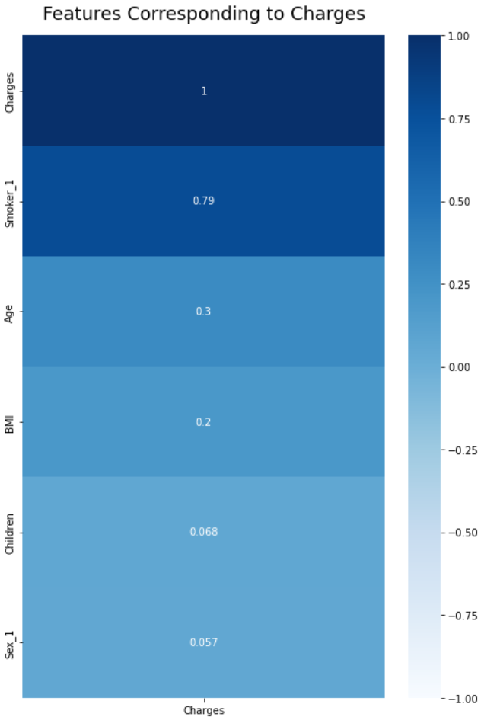
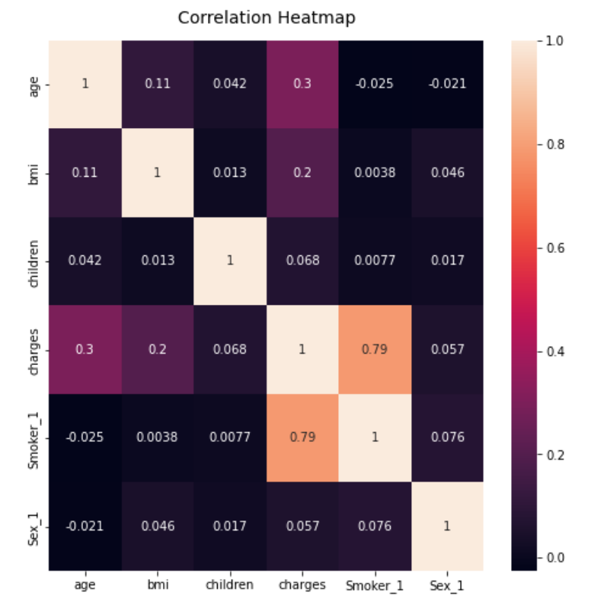
Cleaning the data and finding correlation between variables
Removing unnecessary columns and add columns for additional information (Removing Region column and add columns Smoker_1 and Sex_1 to change to numerical values)
Create heatmap to find the correlation between variables
Conclusion:
Smokers, Age and BMI are the factors
that we will be looking at with regards
to charges
Gender has the least correlation to charges
Smokers have the highest correlation to charges

Slide 6
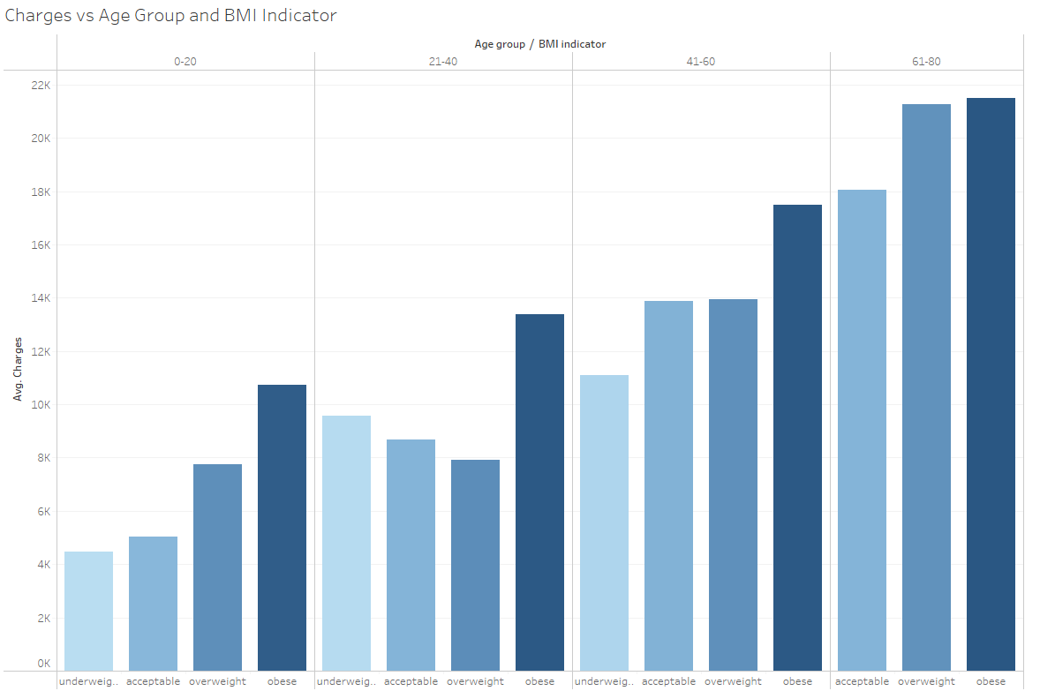


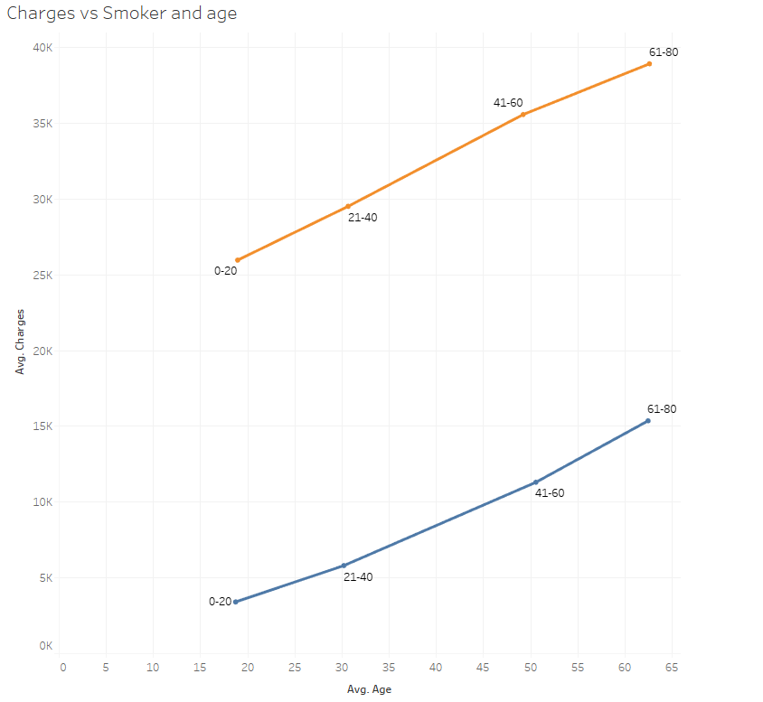
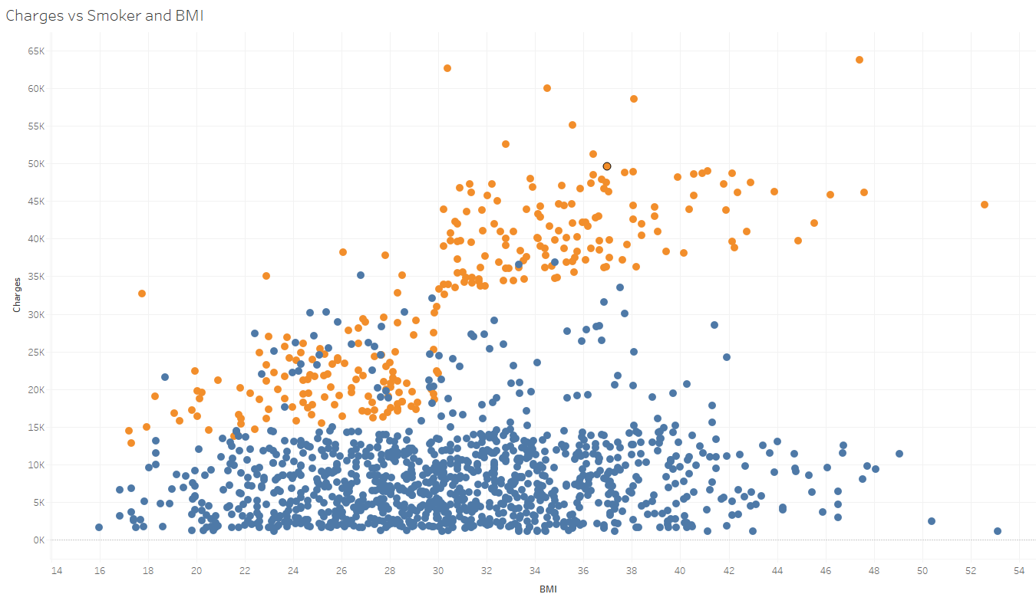
Creating Tableau Charts

Slide 7
Tableau Results – Scatter Plot
It can be seen from the scatter plot that:
The higher the BMI, the higher the charges
A smoker will have higher charges as compared to a non-smoker
A smoker with a high BMI will have the highest charges

Slide 8
Tableau Results – Line Graph
It can be seen from the line graph that:
The age group of 61- 80 will be charged highest on the average, as compared to other age groups
Charges are directly proportional to age
A smoker whom is of the smallest age group (0-20) will be charged a higher premium as compared to a non-smoker of the highest age group (61-80)

Slide 9
Tableau Results – Bar Chart
It can be seen from the bar chart that:
People who are deemed as obese (Based on BMI), will be charged the highest premium out of their age group
There is no clear trend for charges between underweight, acceptable and overweight in each age group

Slide 10
Conclusion:
Smokers are generally charged a higher premium as compared to non-smokers
People of a higher age group are generally charged a higher premium as compared to people of a lower age group
People who are obese are charged the highest premium in their age group
There is no significant relation between underweight, acceptable and overweight with regards to charges.
Key Recommendations:
May need additional information regarding existing health conditions due to certain outliers in the scatter plot. I.e. Low BMI and non-smoker was charged an exceptionally high premium
May also need additional information on any genetic health problems within the family tree that may be passed down to the existing policy holder

Slide 11
Link to Tableau Dashboard:
https://public.tableau.com/app/profile/celin6963/viz/Book4_16395824649270/Dashboard1?publish=yes
Individual Reflections:
Learnt basic python functions, importing and exporting excel
Cleaning up data using python
Picked up SQL and ways to query in SQL
Plot different charts on tableau
Main Challenges
Cleaning the data using python
Plotting graphs in python
Finding the right graphs to plot in Tableau

Slide 12

Thank You!

